Slide 1
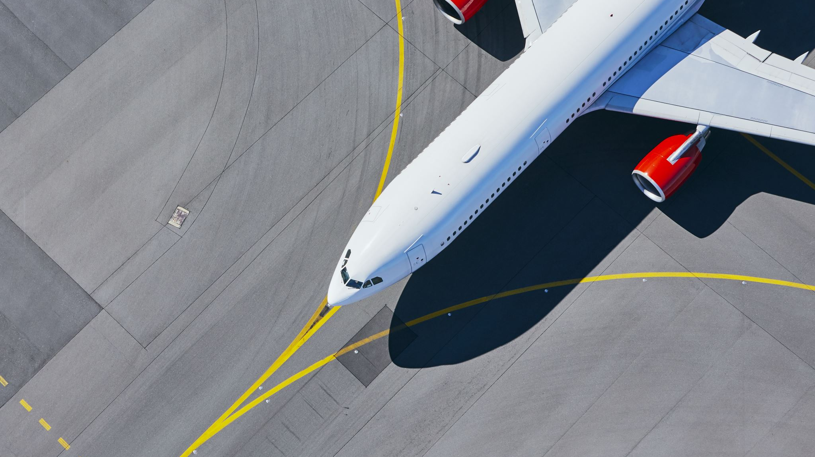

THE CASE FOR AIR TRAVEL
Michael Loos

Slide 2
What’s news?
Recent, unfortunate airline crashes has brought air travel to the forefront of the media
The media is presenting air travel as the one of the most dangerous ways to travel
Should you believe them?

Slide 3
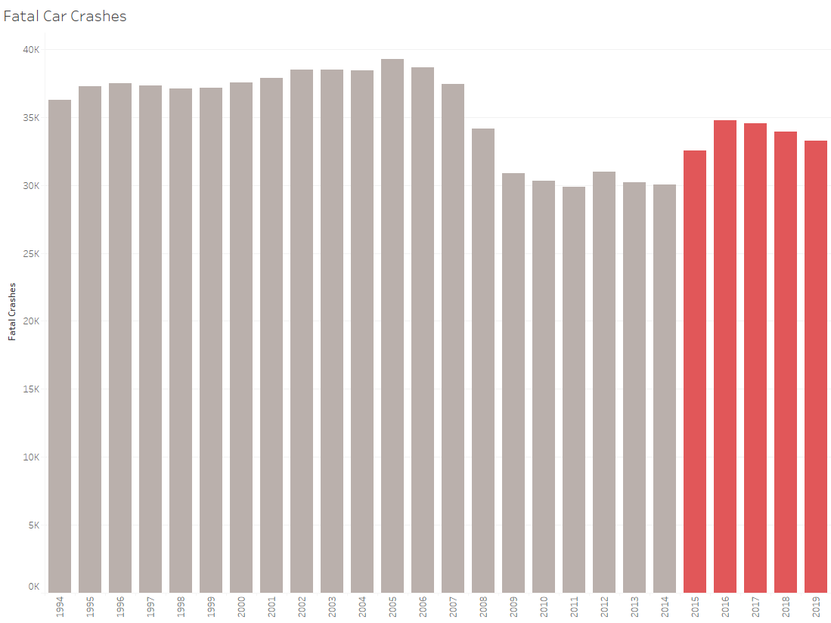
Car Travel IS Becoming More Dangerous
While the media focuses on the danger of air travel, fatal car crashes have been at their highest in years
Notes:
The media is trying to convince you that air travel is dangerous. Can I convince you that car travel is becoming more dangerous?

Slide 4
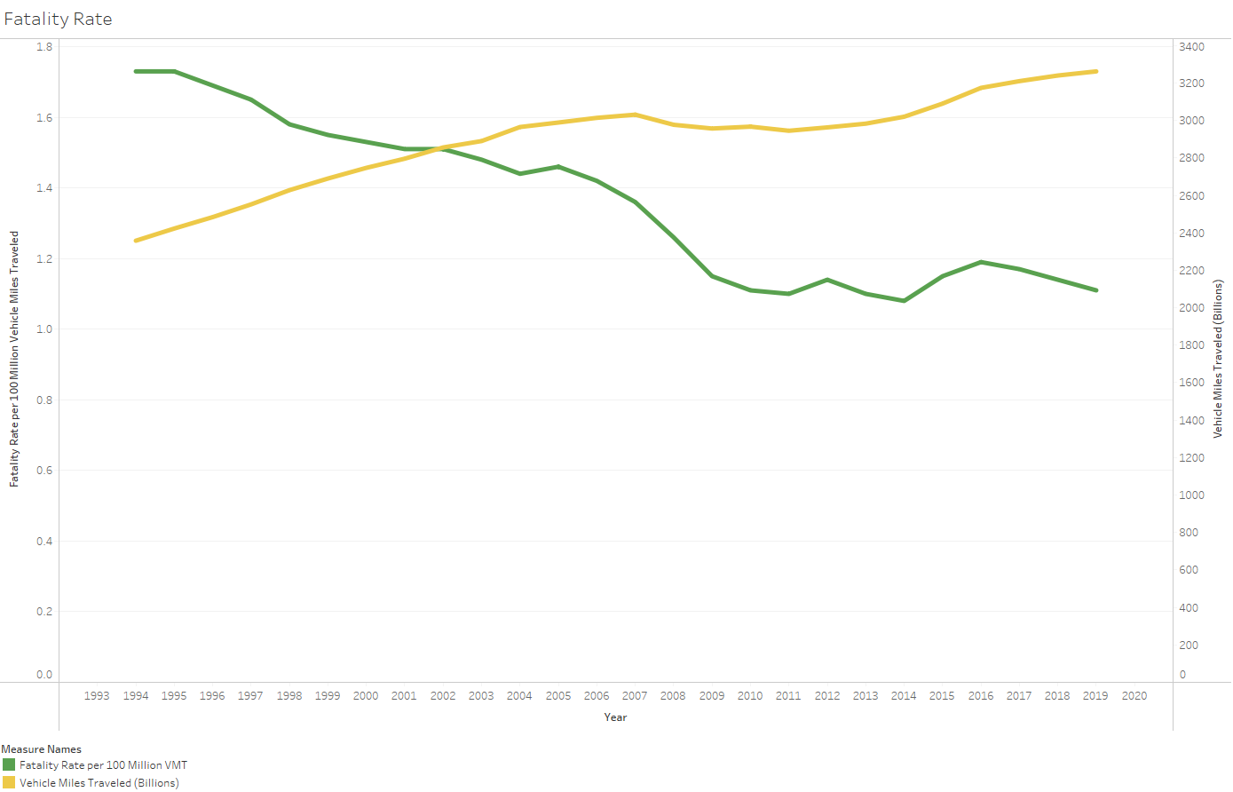
OR IS IT?
Fatality rate has decreased while car travel has increased
The misinformation is comparable to the information being spread by the media about air travel

Slide 5
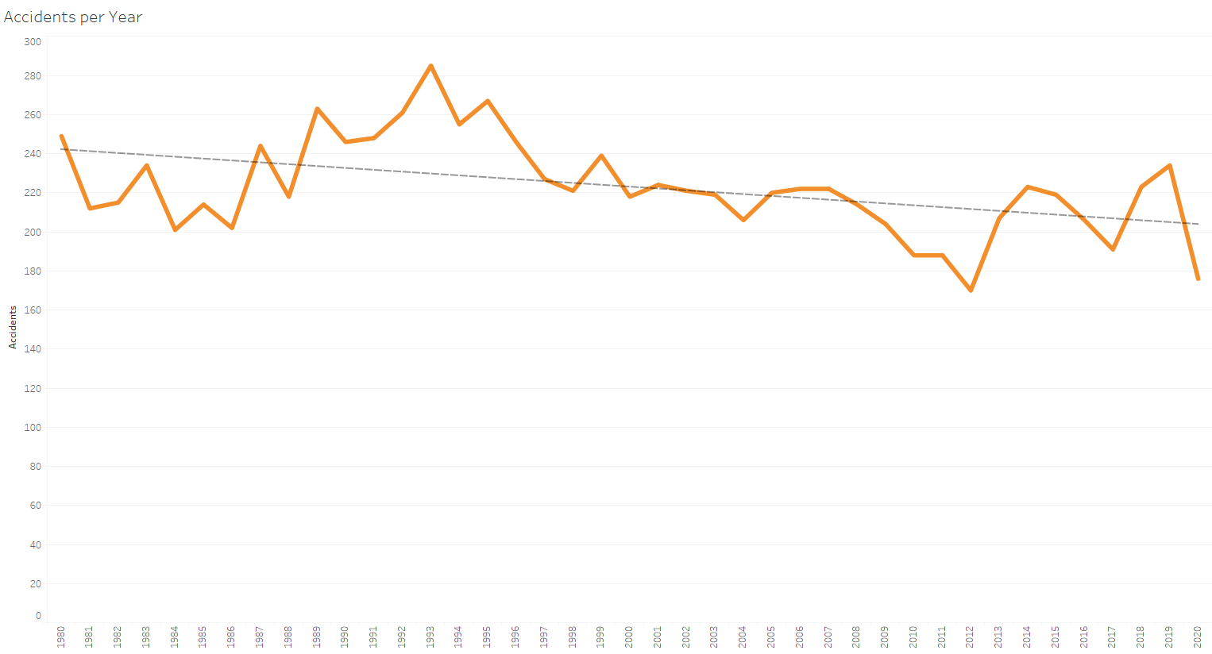
Incidents Decreasing
Accidents per year are on a downward trend
Notes:
While these recent accidents were terribly unfortunate, air travel accidents are on a downward trend

Slide 6
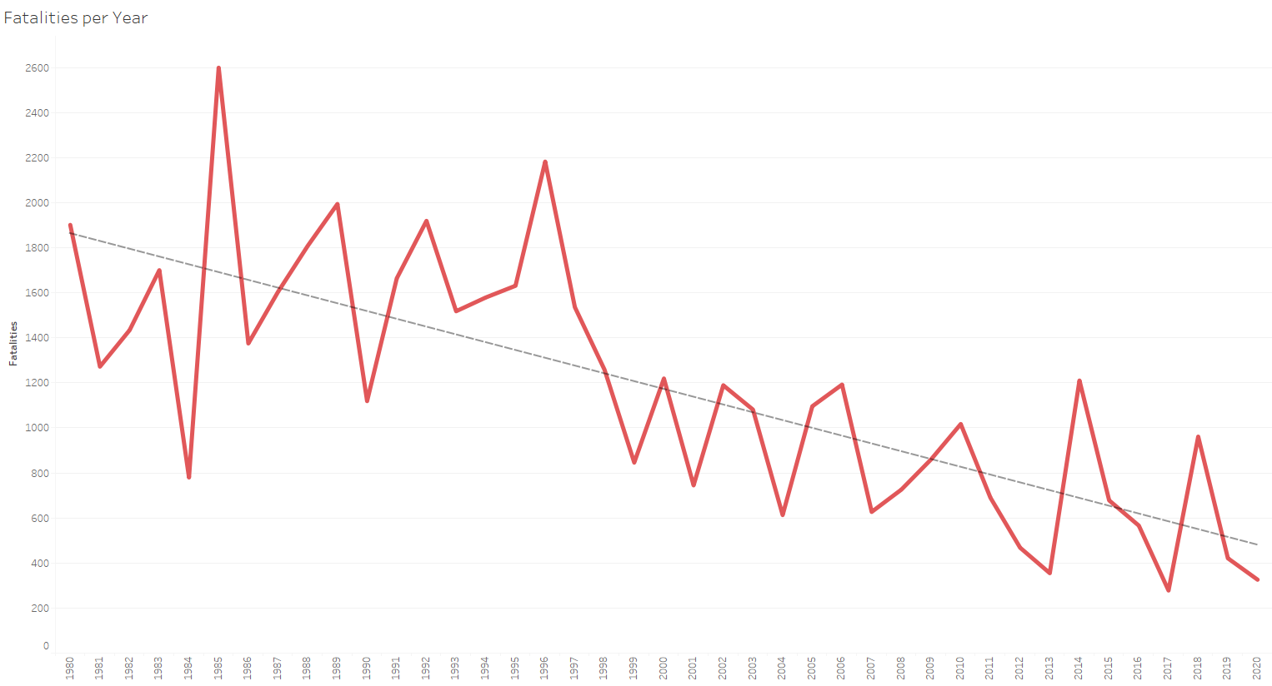
Fatalities plummeting
Fatalities per year are decreasing at an even greater rate than accidents
Notes:
Not only are there fewer accidents. Each accident is resulting in fewer fatalities

Slide 7
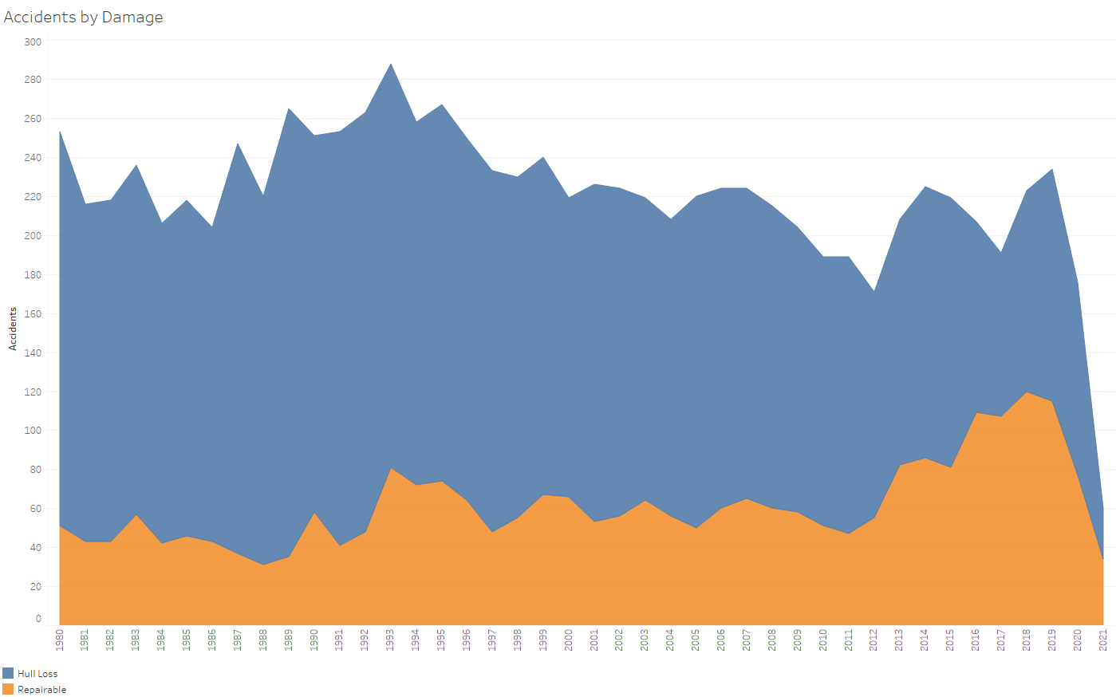
FEWER Accidents, Less Severe Damage
As accidents decrease, they also tend to be more minor
Improved safety measures keep planes intact
Notes:
Demonstrated by the types of accidents.

Slide 8
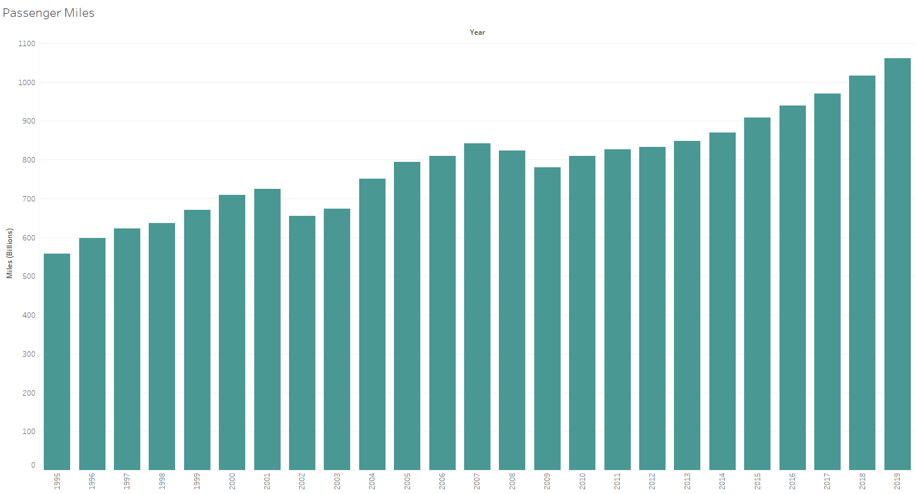
Customers Show Confidence
Customers continue upward trend in air travel
Increase in passenger miles each of the last 10 years
1.06 trillion miles flown by passengers in 2019
Notes:
You might think air travel is decreasing. No. Just like car travel it is increasing. It really is safer.

Slide 9
Fly loos airlines
Safety measures and improved technology has made air travel safer than ever
Fewer, less severe accidents have led to decreased fatalities
Passengers continue to show their belief in flight with increased travel
Let Loos Airlines take you there

